Slide 2
Using machine learning generated open data to create an analytical toolset and sustainability assessment of properties at risk for flooding in Indiana local communities.
Justin P. Peters, Ph.D. Student, Department of Information and Library Science Indiana University School of Informatics, Computing, and Engineering
Notes:
One thing universities are good at is bringing together experts.
We host a webinar series to help guide you to the right solutions for your community.

Slide 3
Part 1: A tale of disparate datasets
1. Indiana County Assessor data for Real Property – Assessed values of parcels
2. Microsoft AI generated building footprints
3. FEMA/IDNR Digital Flood Insurance Rate Maps (DFIRM) 100 and 500 year floodplains

Slide 4
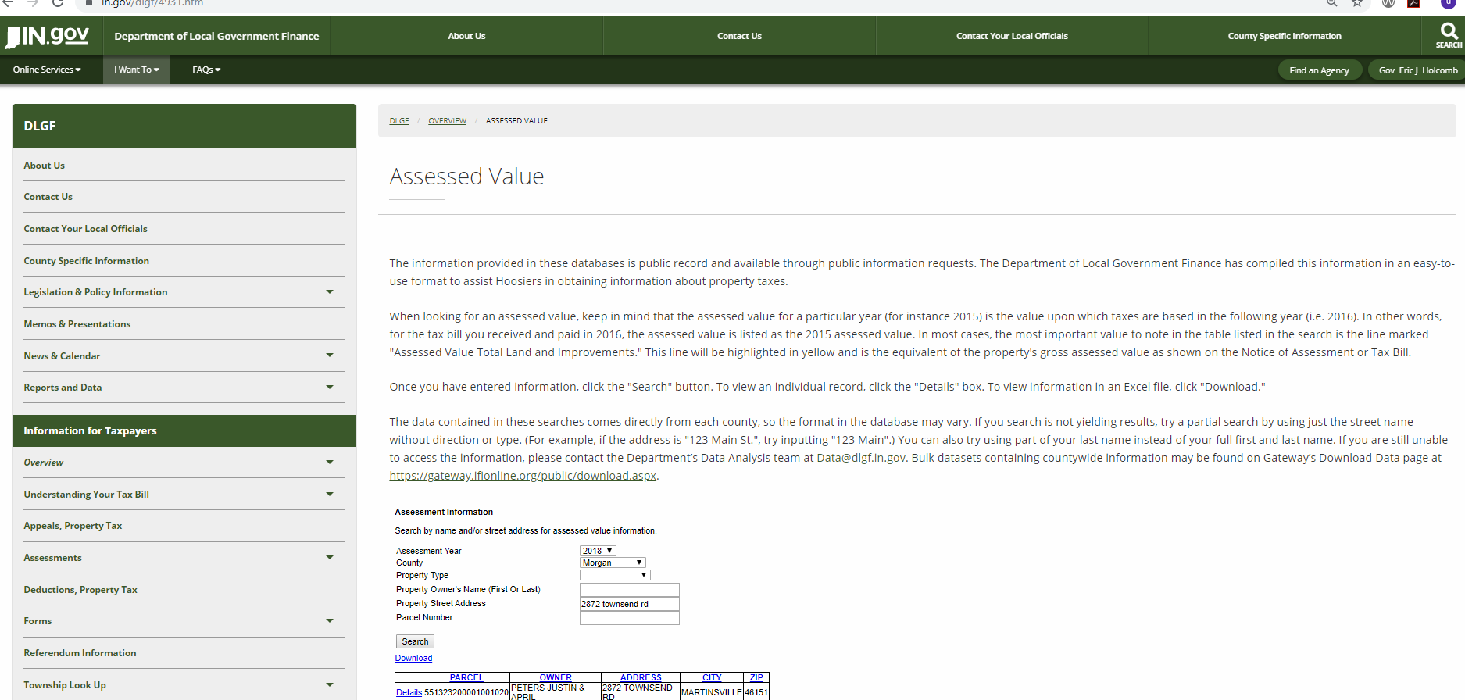
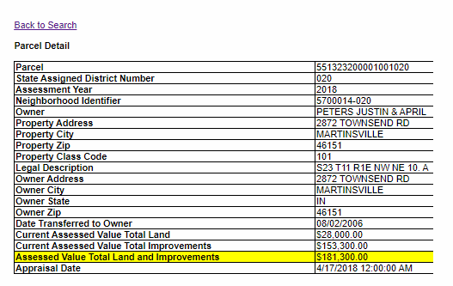
https://www.in.gov/dlgf/4931.htm
Notes:
One thing universities are good at is bringing together experts.
We host a webinar series to help guide you to the right solutions for your community.

Slide 5
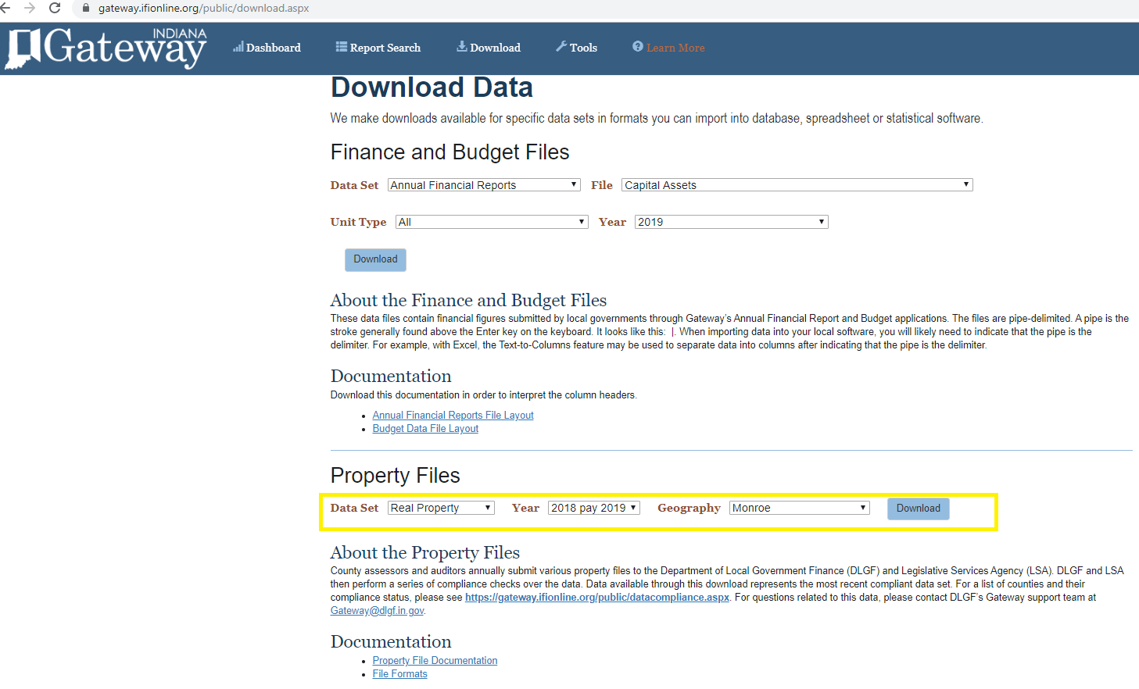
https://gateway.ifionline.org/public/download.aspx
Notes:
One thing universities are good at is bringing together experts.
We host a webinar series to help guide you to the right solutions for your community.

Slide 6
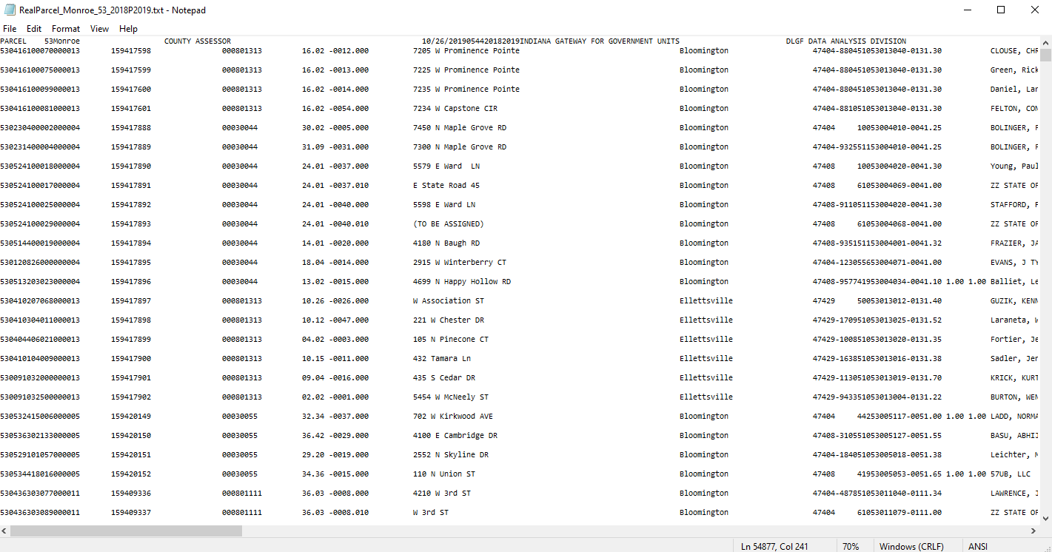
Notes:
One thing universities are good at is bringing together experts.
We host a webinar series to help guide you to the right solutions for your community.

Slide 7
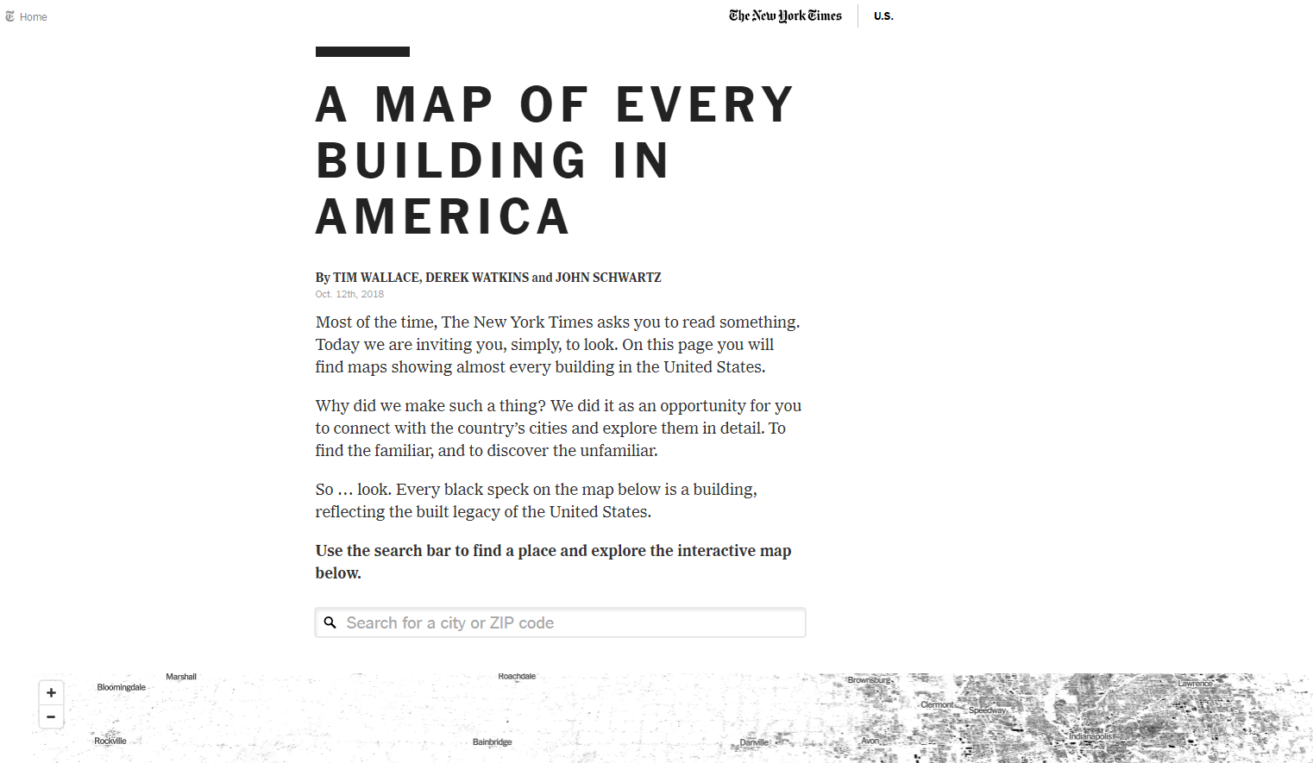
https://www.nytimes.com/interactive/2018/10/12/us/map-of-every-building-in-the-united-states.html
Notes:
One thing universities are good at is bringing together experts.
We host a webinar series to help guide you to the right solutions for your community.

Slide 8
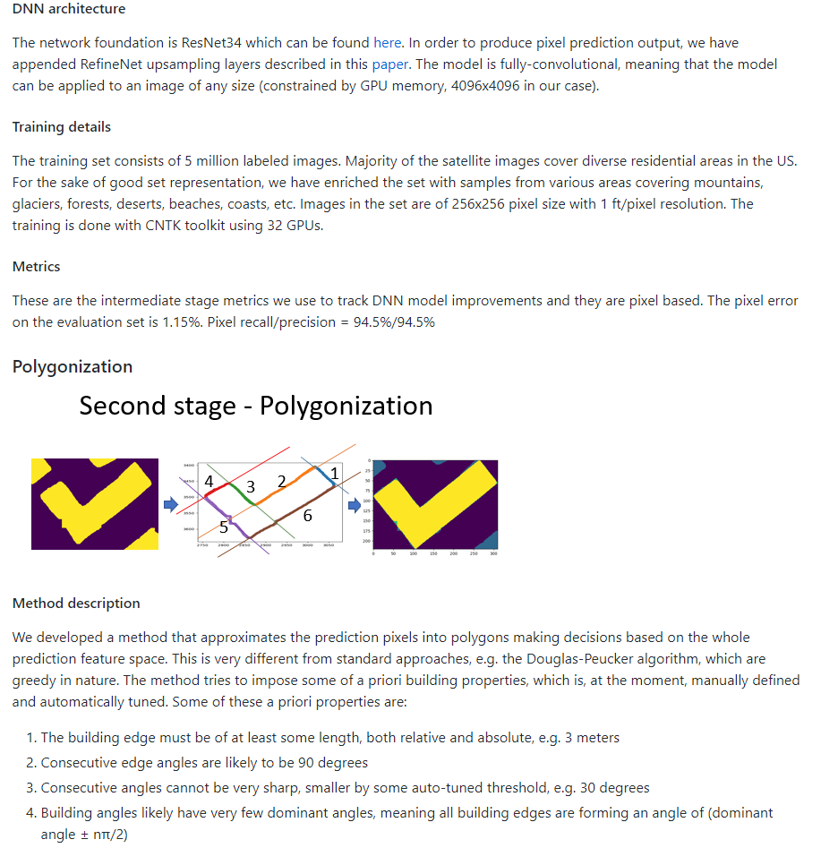
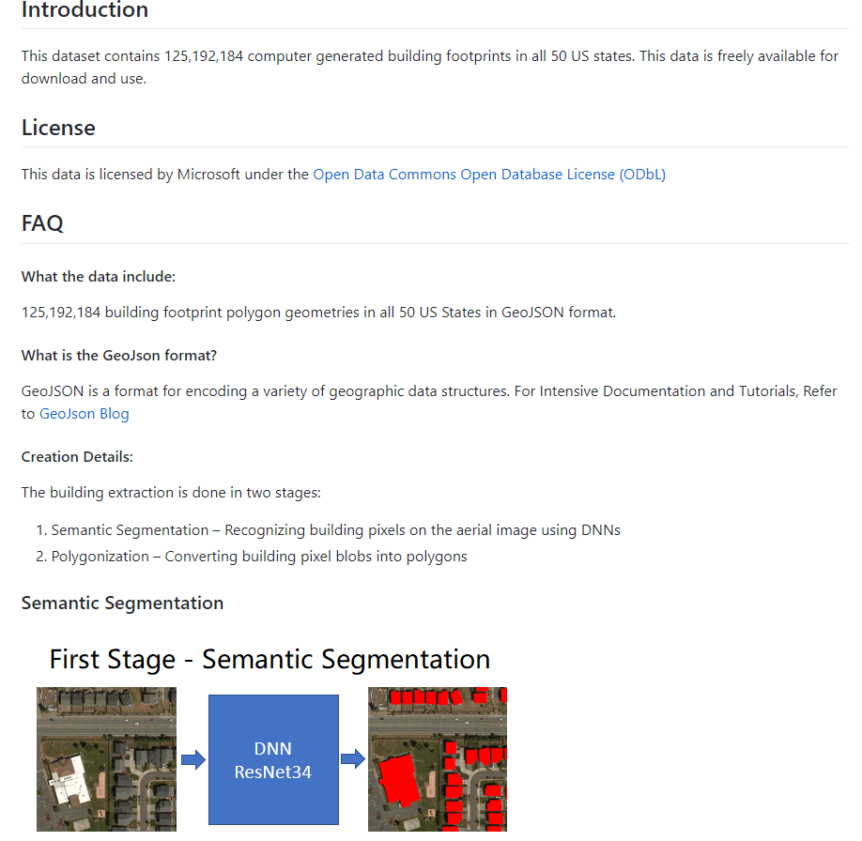
https://github.com/microsoft/USBuildingFootprints
Notes:
One thing universities are good at is bringing together experts.
We host a webinar series to help guide you to the right solutions for your community.

Slide 9
https://github.com/microsoft/USBuildingFootprints
State | Number of Buildings | Unzipped MB
Alabama | 2,460,404 | 526
Alaska | 110,746 | 26
Arizona | 2,555,395 | 584
Arkansas | 1,508,657 | 321
California | 10,988,525 | 2,537
Colorado | 2,080,808 | 466
Connecticut | 1,190,229 | 258
Delaware | 345,907 | 75
District Of Columbia | 58,329 | 13
Florida | 6,903,772 | 1,521
Georgia | 3,873,560 | 825
Hawaii | 252,891 | 56
Idaho | 883,594 | 198
Illinois | 4,855,794 | 1,033
Indiana | 3,268,325 | 700
3,612,113 parcels in Indiana
Notes:
One thing universities are good at is bringing together experts.
We host a webinar series to help guide you to the right solutions for your community.

Slide 10
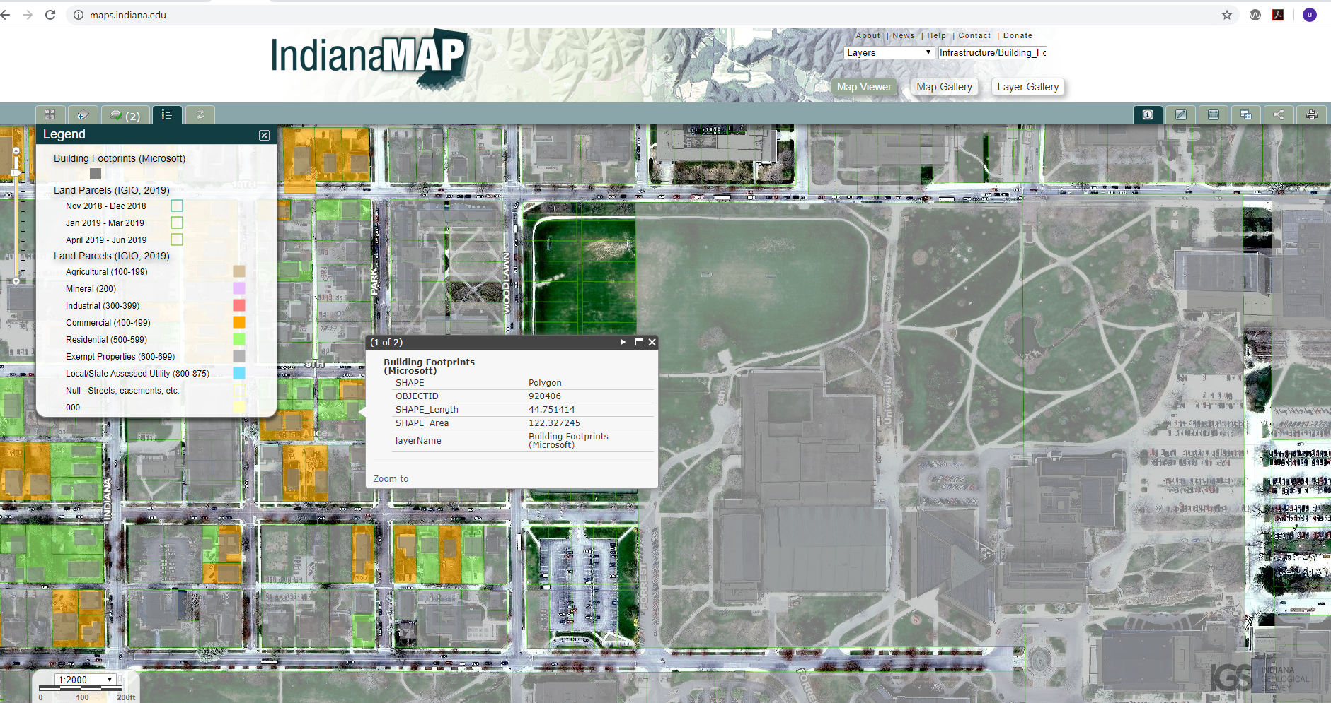
https://github.com/microsoft/USBuildingFootprints
Notes:
One thing universities are good at is bringing together experts.
We host a webinar series to help guide you to the right solutions for your community.

Slide 11
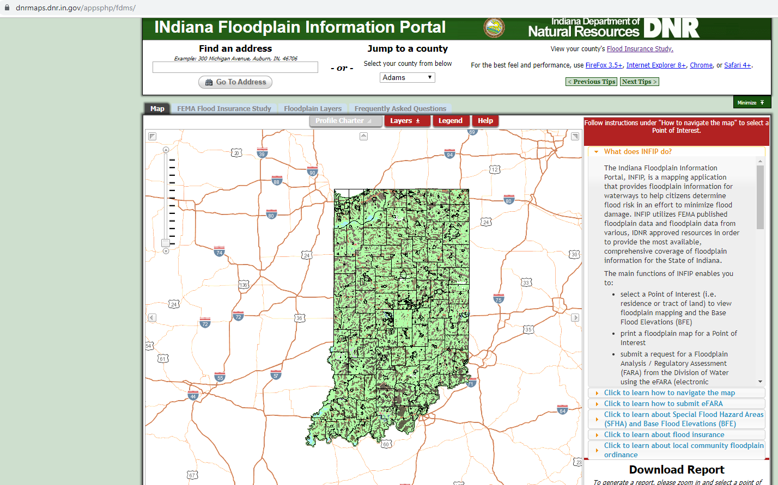
https://dnrmaps.dnr.in.gov/appsphp/fdms/
Notes:
One thing universities are good at is bringing together experts.
We host a webinar series to help guide you to the right solutions for your community.

Slide 12
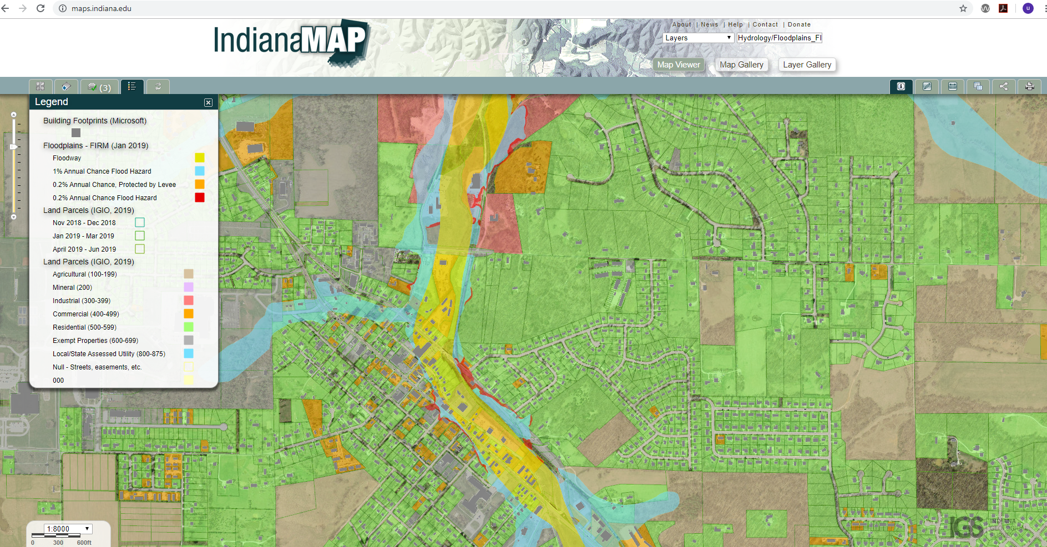
https://dnrmaps.dnr.in.gov/appsphp/fdms/
Notes:
One thing universities are good at is bringing together experts.
We host a webinar series to help guide you to the right solutions for your community.

Slide 13
https://dnrmaps.dnr.in.gov/appsphp/fdms/
2 main research objectives:
Produce a combined spatial analysis of the three datasets to provide a risk assessment for local communities (Indiana cities and counties). This includes ranking cities and counties by potential financial loss for 100 and 500 year flood events.
Creation of a modeling toolset to allow user generated custom disaster event scenarios and reporting potential financial losses.
Notes:
One thing universities are good at is bringing together experts.
We host a webinar series to help guide you to the right solutions for your community.

Slide 14
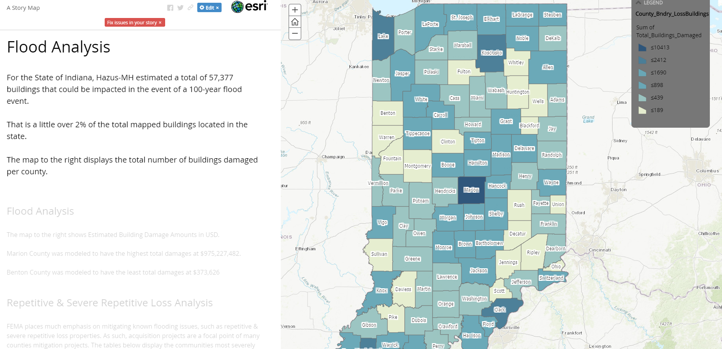
https://iu.maps.arcgis.com/apps/MapJournal/index.html?appid=e7e4f40a5fe34eb8af4576212fe23298
Notes:
One thing universities are good at is bringing together experts.
We host a webinar series to help guide you to the right solutions for your community.

Slide 15
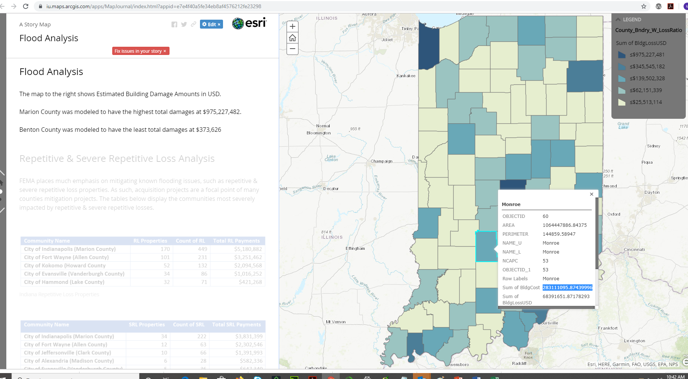
https://iu.maps.arcgis.com/apps/MapJournal/index.html?appid=e7e4f40a5fe34eb8af4576212fe23298
Notes:
One thing universities are good at is bringing together experts.
We host a webinar series to help guide you to the right solutions for your community.

Slide 16
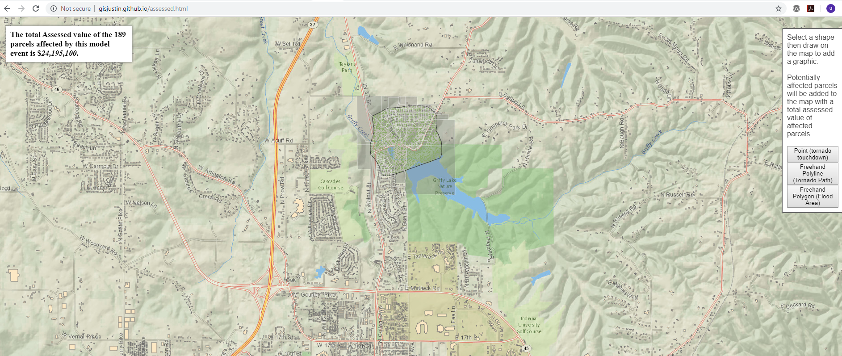
https://iu.maps.arcgis.com/apps/MapJournal/index.html?appid=e7e4f40a5fe34eb8af4576212fe23298
Notes:
One thing universities are good at is bringing together experts.
We host a webinar series to help guide you to the right solutions for your community.

Slide 17
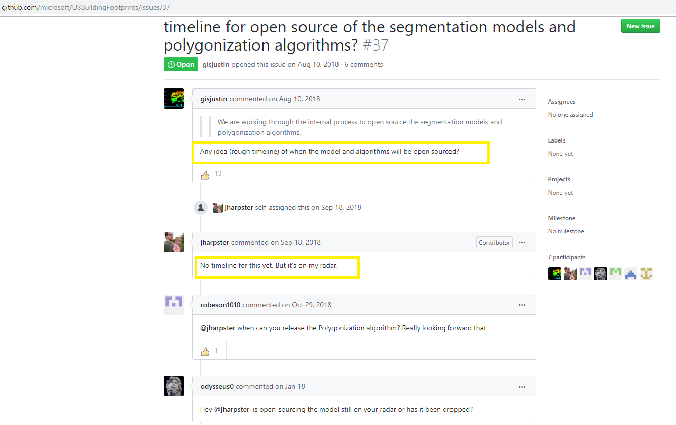
Potential future objectives and issues to be resolved
Using Microsoft’s algorithm on different vintages of aerial photography (historical and future)
Microsoft has stated they will be open sourced
..After over a year of asking, not holding my breath
Notes:
One thing universities are good at is bringing together experts.
We host a webinar series to help guide you to the right solutions for your community.

Slide 18
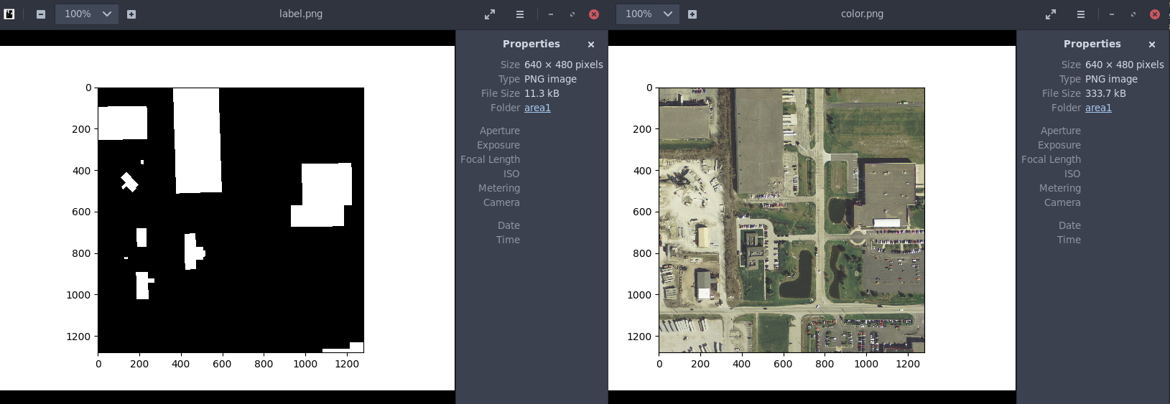
Potential future objectives and issues to be resolved
Created training model with Research Technologies in IU HPC environment.
Model is very good at identifying pixels that make up buildings.
Notes:
One thing universities are good at is bringing together experts.
We host a webinar series to help guide you to the right solutions for your community.

Slide 19
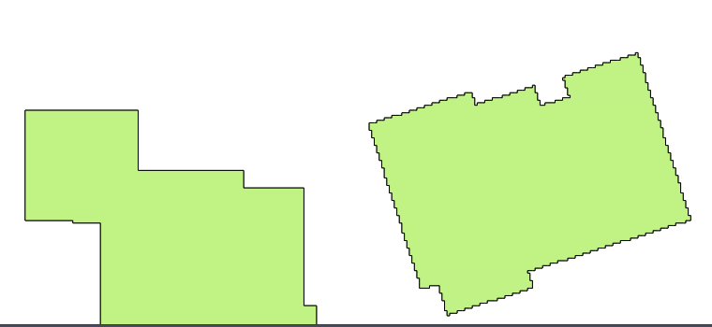
Potential future objectives and issues to be resolved
Turning pixels into polygons (ploygonization algorithm) needs work
Notes:
One thing universities are good at is bringing together experts.
We host a webinar series to help guide you to the right solutions for your community.

Slide 20
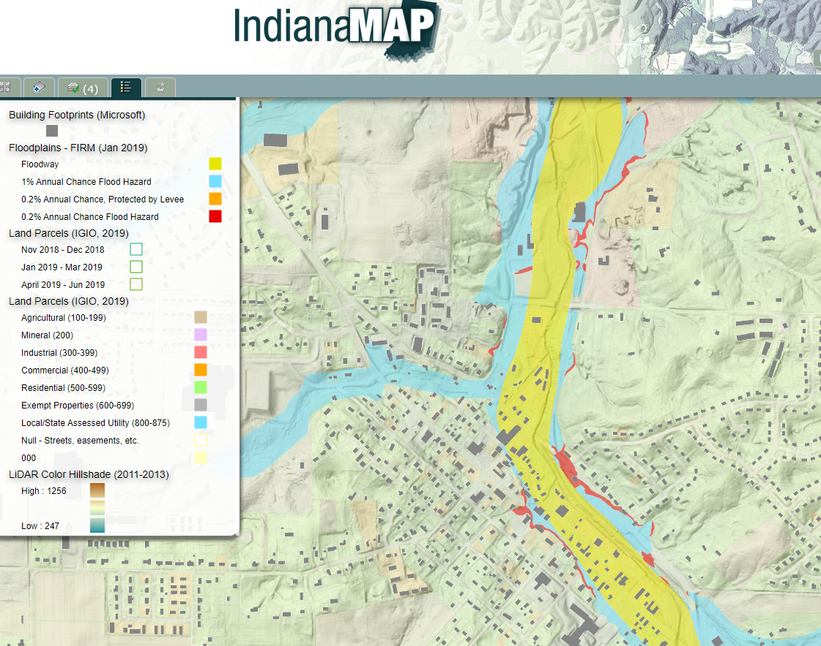
Potential future objectives and issues to be resolved
Incorporating Digital Elevation Model (DEM) datasets into toolset to account for elevation when modeling custom scenarios
Notes:
One thing universities are good at is bringing together experts.
We host a webinar series to help guide you to the right solutions for your community.

